Slide 1
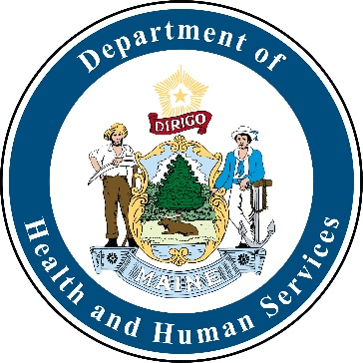
Mosquito Monitoring, Maine 2021
Sara Robinson, MPH
June 17, 2022

Slide 2
2021 Mosquito Monitoring
Trapping in 10 counties
  Androscoggin, Cumberland, Kennebec, Hancock, Lincoln, Oxford, Penobscot, Sagadahoc, Waldo, York
Trapping in 33 towns
  Alfred, Argyle Township, Arrowsic, Auburn, Augusta, Bangor, Bar Harbor, Belgrade, Biddeford, Dresden, Edgecomb, Eliot, Farmingdale, Gray, Greenbush, Kennebunk, Kittery, Lebanon, Lewiston, Livermore, Lyman, Mt. Desert, Norway, Palermo, Portland, Sidney, South Berwick, Standish, Turner, Unity Township, Waterford, Wells, Wiscasset, York

Slide 3
2021 Mosquito Monitoring
1025 pools tested at HETL
  0 pools positive for West Nile Virus
  0 pools positive for Eastern Equine Encephalitis

Slide 4
2021 Human results
27 humans tested for arboviral illnesses at HETL
  0 positives
1 individual tested positive for West Nile on a blood donation and is considered a presumptive viremic donor
1 individual tested positive for Jamestown Canyon virus

Slide 5
Mosquito Monitoring Funding
Funding from federal CDC is sporadic at best
  Notification of award comes in the end of July/beginning of August (after the trapping season starts)
Funds from the Board of Pesticide Control allow us to have consistency in our trapping sites from year to year

Slide 6
Questions?
Sara Robinson, MPH
Infectious Disease Epidemiology Program Director
Sara.Robinson@maine.gov
207-287-4610

